Slide 1
Mạng thông tin di động 3G
UMTS / W-CDMA
(Universal Mobile Telecommunications System)
ξ 2. Nguyên lý trải phổ và sử dụng mã trong UMTS

Slide 2
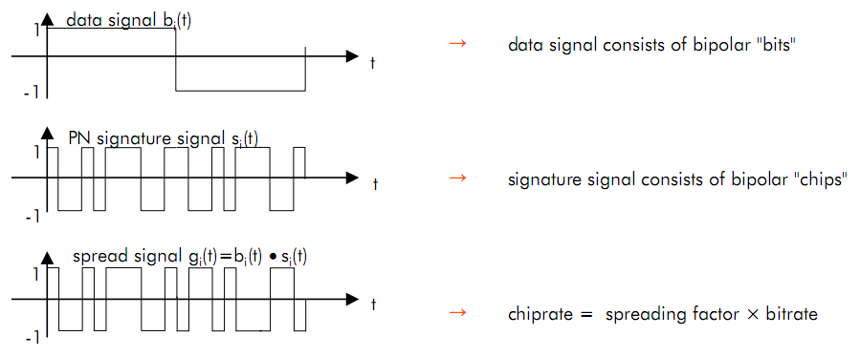
Principle of spreading

Slide 3
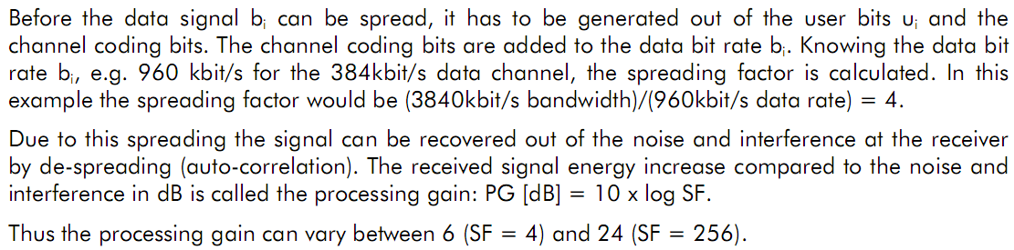
Principle of spreading

Slide 4
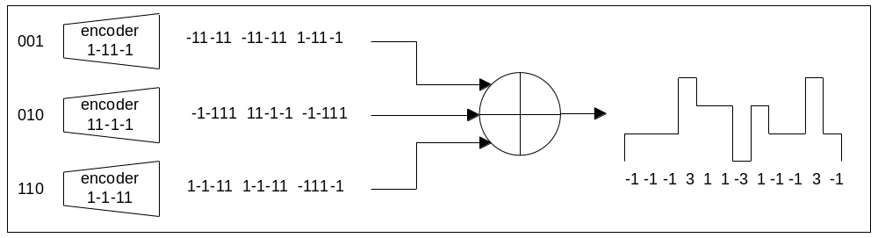
Trải phổ và giải trải phổ
Spreading

Slide 5
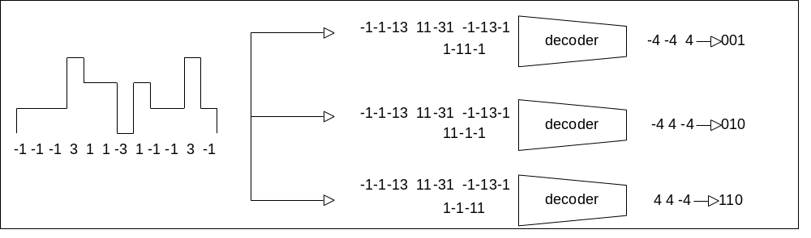
Trải phổ và giải trải phổ
Spreading
De-Spreading

Slide 6
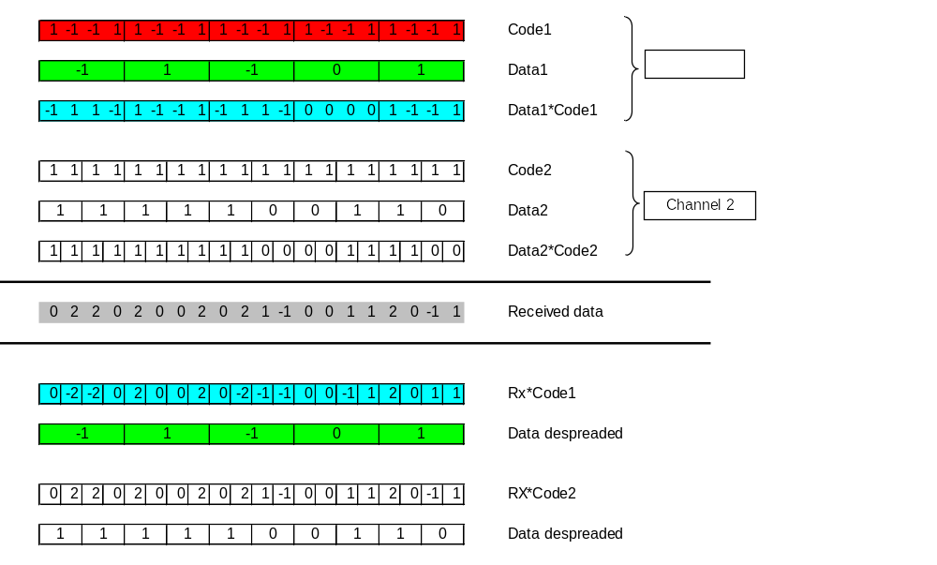
1 -1 -1 1 1 -1 -1 1 1 -1 -1 1 1 -1 -1 1 1 -1 -1 1
-1
-1 1 1 -1
-1
-1
-1
-1 -1 -1 -1
-1 -1
Rx - Received data ?
Rx * Code1
Data de-spreaded
Rx * Code2
Data de-spreaded

Slide 7
1 -1 -1 1 1 -1 -1 1 1 -1 -1 1 1 -1 -1 1 1 -1 -1 1
-1
-1 1 1 -1
-1
-1
-1
-1 -1 -1 -1
-1 -1
0
-2
-2
2
0
-2
0
Rx * Code1
Data de-spreaded
Rx * Code2
Data de-spreaded

Slide 9

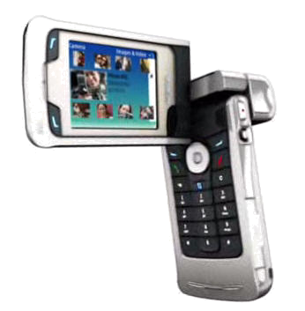
Codes in UMTS
Channelization codes separate different connection
Scrambling codes separate cells/sectors
Downlink

Slide 10
Codes in UMTS
Channelization codes separate data/control channels
Scrambling codes separate different mobiles
Uplink

Slide 11
Codes in UMTS
Channelization codes separate data/control channels
Channelization codes separate different connection
Scrambling codes separate cells/sectors
Scrambling codes separate different mobiles
Downlink
Uplink

Slide 12
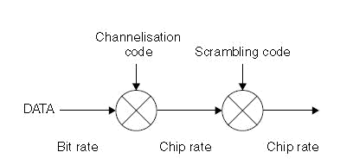
Codes in UMTS

Slide 13
Codes in UMTS
Channelization Codes (=short codes)
  Defines how many chips are used to spread a single information bit and thus determines the end bit rate
    Length is referred as spreading factor
  Used for:
    Downlink: Separation of downlink connections to different users within one cell
    Uplink: Separation of data and control channels from same terminal
  Same channelization codes in every cell / mobiles
    additional scrambling code is needed

Slide 14
Codes in UMTS
Scrambling codes (=long codes)
  Very long (38400 chips), many codes available
  Does not spread the signal
  Used for
    Downlink: to separate different cells/sectors
    Uplink: to separate different mobiles
  The correlation between two codes (two mobiles/NodeBs) is low

Slide 15
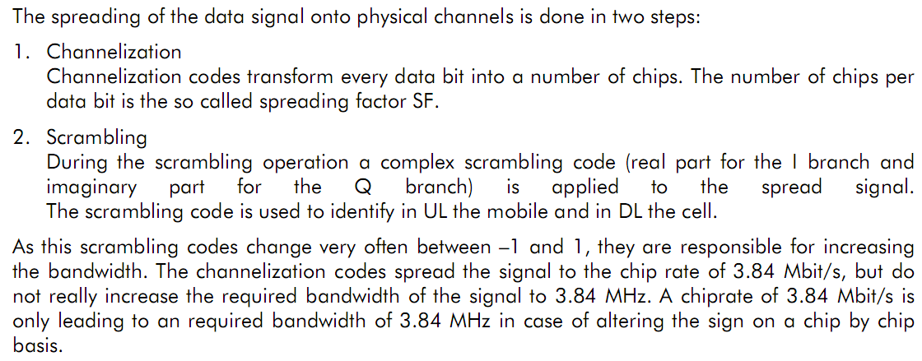
Codes used

Slide 16
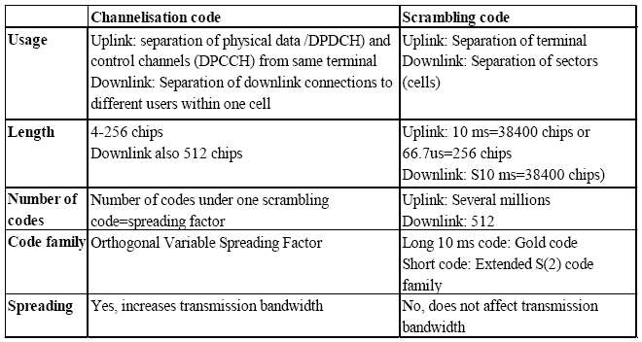
Codes and their Use

Slide 17
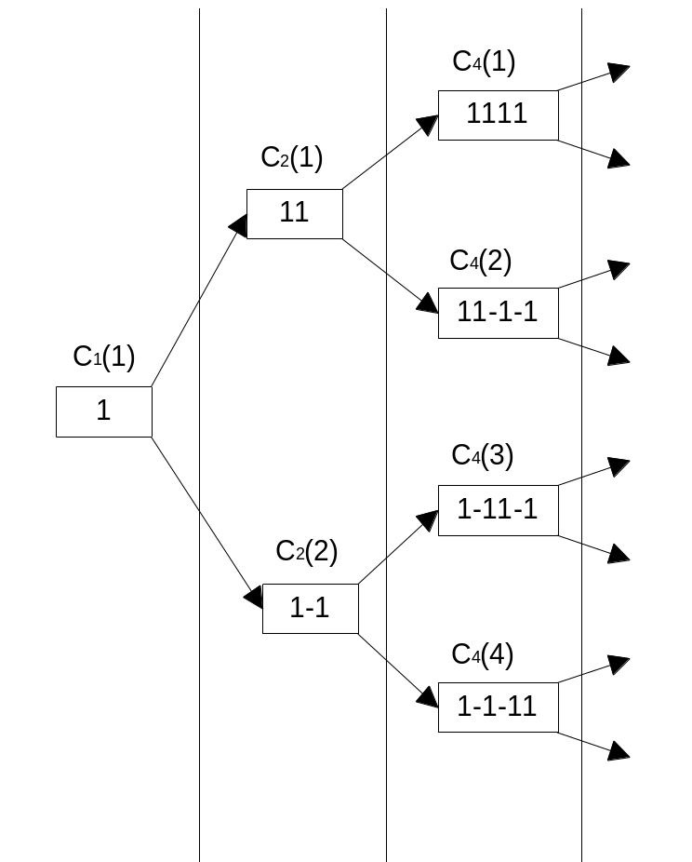
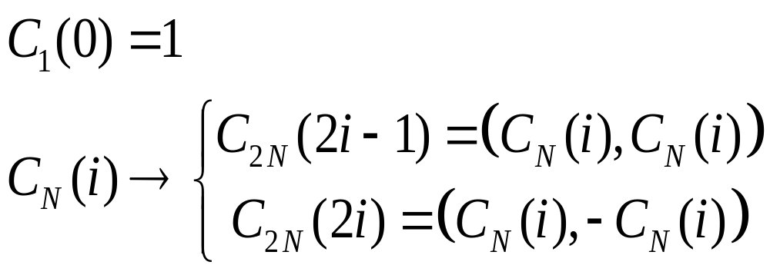
Orthogonal Variable Spreading Factor Codes
OVSF code
Recursive rule

Slide 18
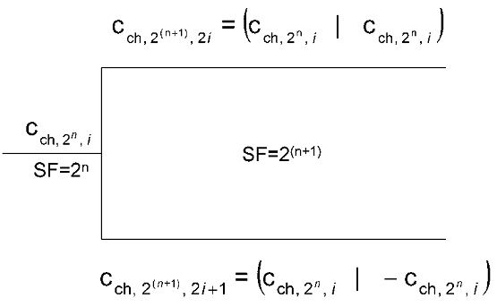
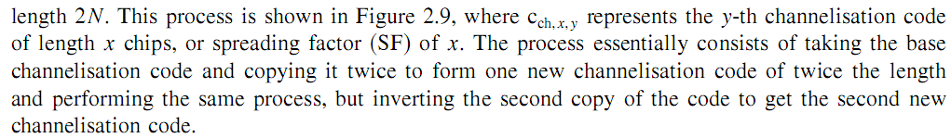
Channelisation code generation process

Slide 19
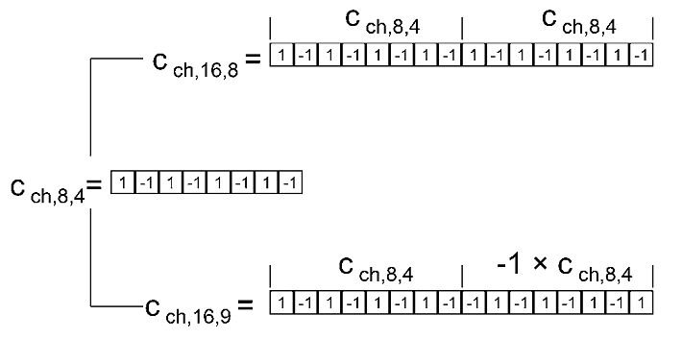
An example of the generation of two channelisation codes

Slide 20
An example of the generation of two channelisation codes

Slide 21
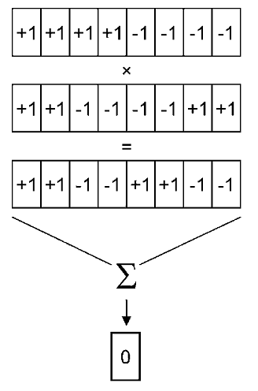
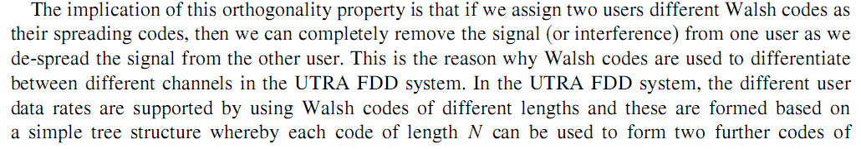
The orthogonality property of Walsh codes

Slide 22
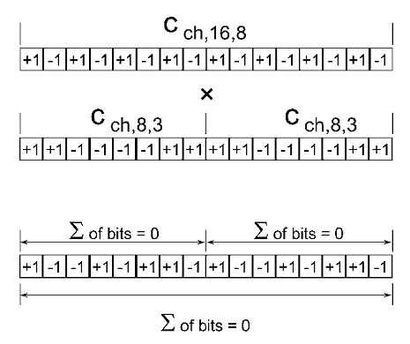
The orthogonality property
of different length OVSF codes

Slide 23
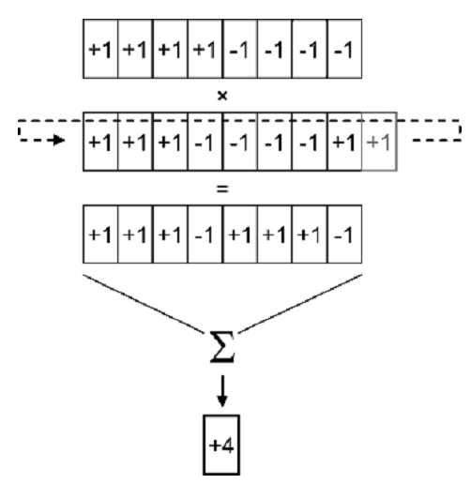
The cross correlation of two
different Walsh codes with a non-zero offset

Slide 24
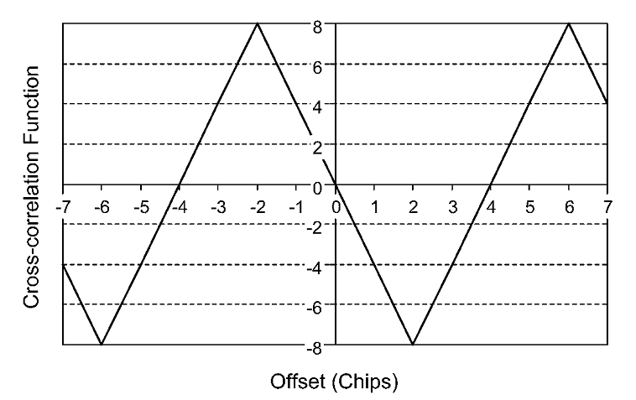
An example cross correlation function of two eight-chip Walsh codes

Slide 25
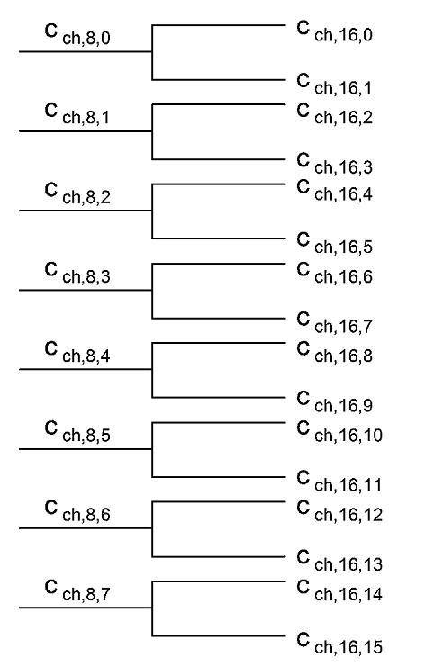
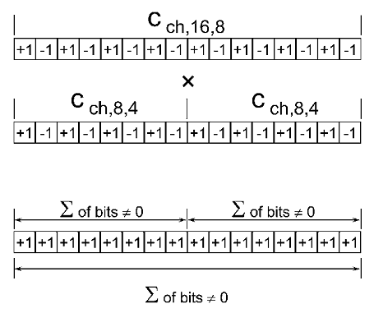
The cross correlation of codes
from the same branch of the code tree

Slide 26
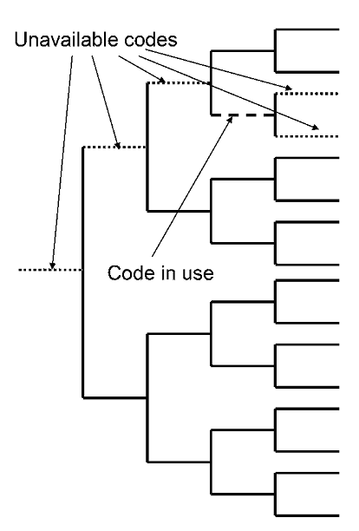
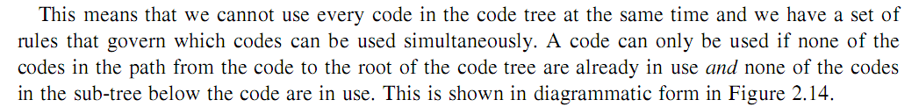
Channelisation code allocation rules

Slide 27
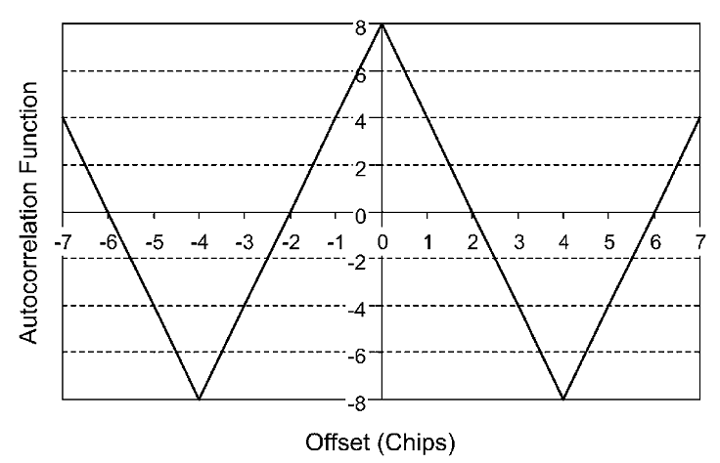
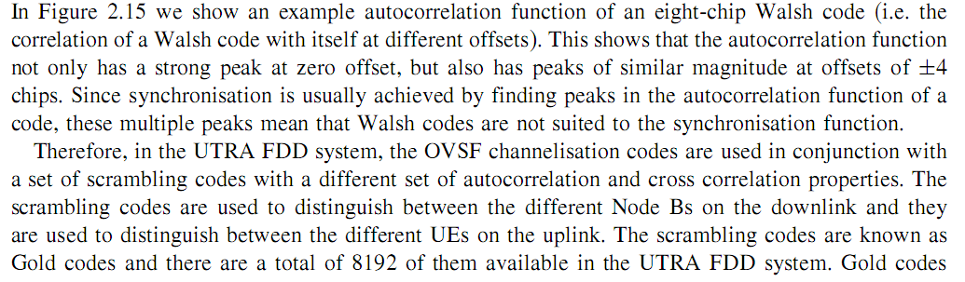
An example autocorrelation function of a Walsh code

Slide 28
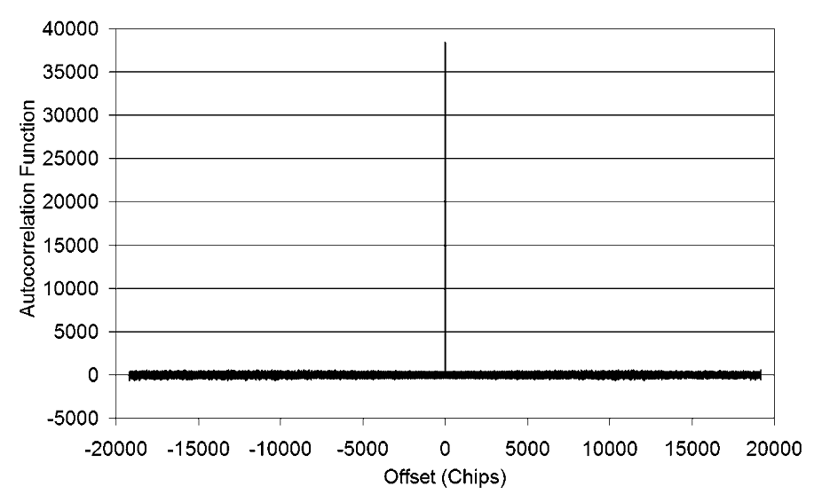
The autocorrelation correlation properties of scrambling codes

Slide 29
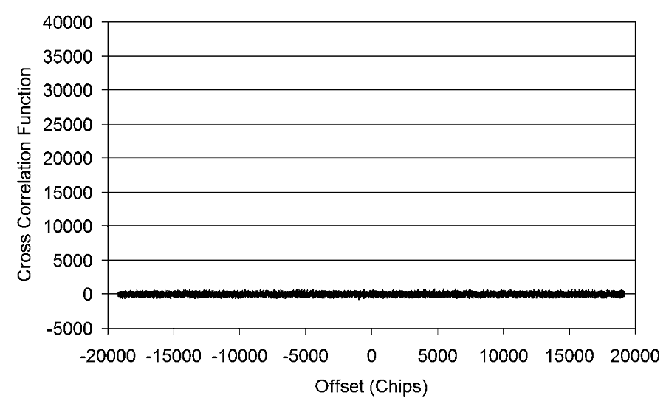
The cross correlation properties of scrambling codes

Slide 30
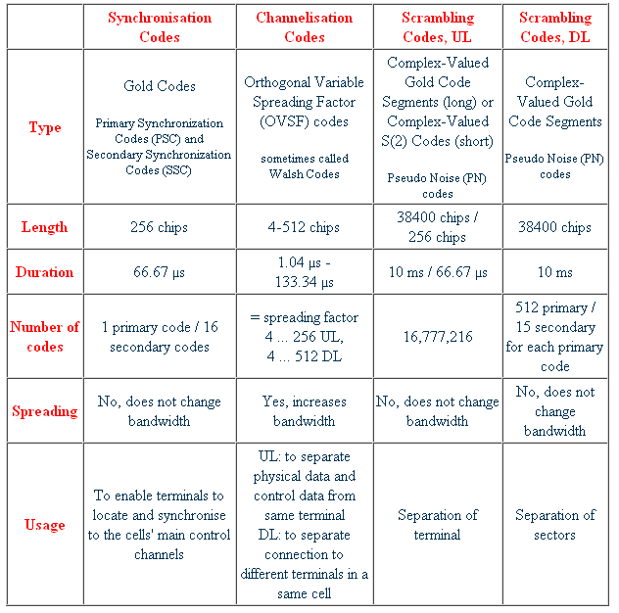
Main UMTS Codes
http://www.umtsworld.com/technology/codes.htm

